Slide 1

Where to open a new brewery in Charleston SC

Slide 2
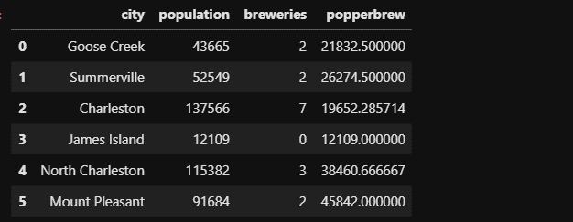
Population analysis

Slide 3
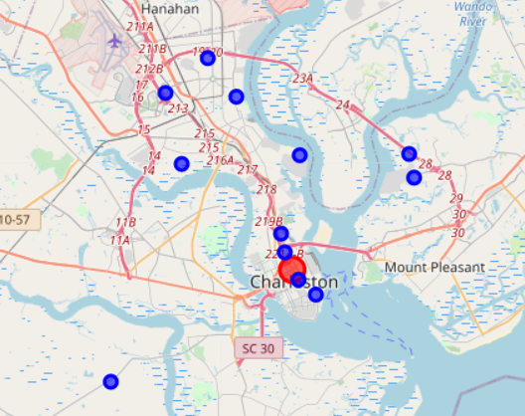
Plotting existing breweries
The red marker is a random address that I used to be the center point, while the blue markers each mark existing breweries

Slide 4
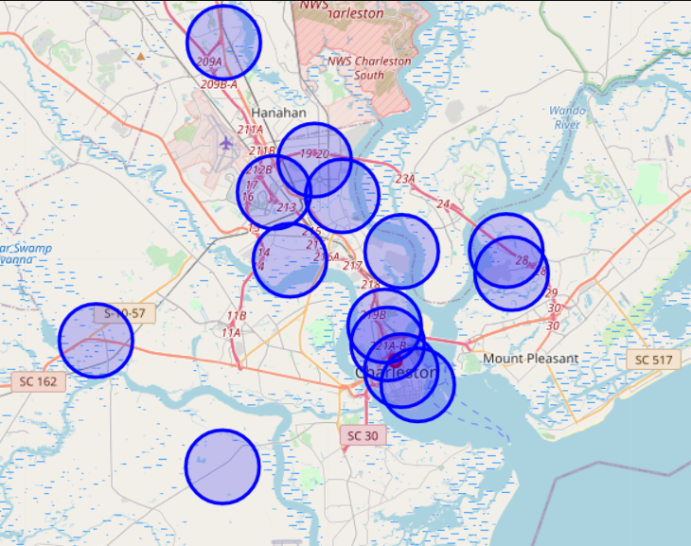
Analyzing brewery density and distance
By increasing the radius of the map marker, we can get a quick idea of how far apart each brewery is from one another, and identify areas that are not near a brewery.

Slide 5

Testing the waters
Reviews of several breweries were analyzed using 4square to assess the competition in each of the surrounding areas

Slide 6
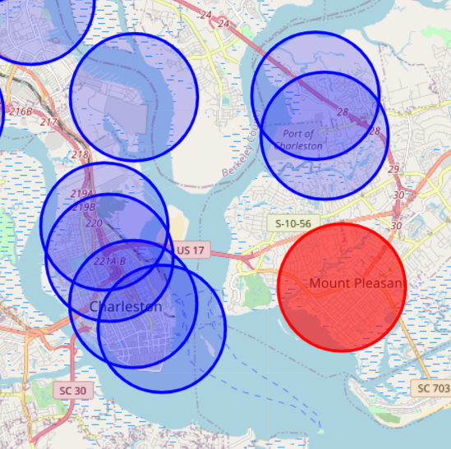
Focusing on a location
Due to the high population-to-brewery ratio and distance from other breweries, the area in red appears to be an ideal place

Slide 7
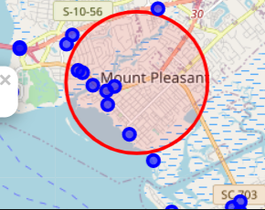
Getting to know the neighbors
4square was used to check nearby venues to identify any red flags or undesirable neighbors. Fortunately, the surrounding businesses appear to be desirable and generally speaking it appears to be a nice area.

